Slide 1


THE IMPORTANCE OF CYBERSECURITY
Prepared By:- Syed Badar Ali Naqvi 24K-3079

Slide 2
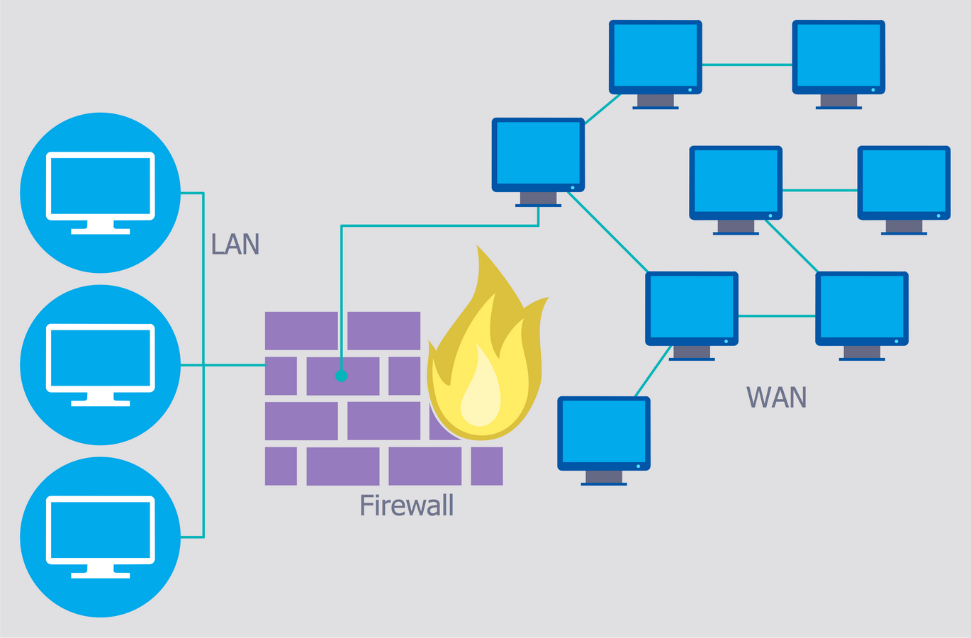
What is Cybersecurity?
Cybersecurity refers to the practice of protecting systems, networks, and data from cyber attacks. It involves a combination of technologies, processes, and practices designed to guard against unauthorized access, data breaches, and other online threats.
Why It Is Crucial:
Individuals, businesses, and governments rely on online systems for everything from banking to healthcare, making cybersecurity essential to prevent financial loss, identity theft, and national security threats.

Slide 3
Common Cybersecurity Threats
Malware: Malicious software, such as viruses, worms, or trojans, designed to damage or disrupt systems, steal sensitive information, or spy on users.
Phishing: Fraudulent attempts to obtain sensitive information (like passwords or credit card details) by disguising as trustworthy entities, usually through email.
Ransomware: A type of malware that encrypts the victim’s data and demands a ransom payment to restore access.
DDoS Attacks (Distributed Denial of Service): An attack where multiple systems overwhelm a server or website, making it inaccessible to users.

Slide 4
Statistics and Real-Life Examples of Cybersecurity Breaches
Equifax Data Breach (2017):
Impact: 147 million people’s sensitive information (including Social Security numbers) was compromised.
Consequence: Financial loss and severe damage to Equifax’s reputation.
Yahoo Data Breach (2013-2014):
Impact: 3 billion accounts were affected by two separate breaches.
Consequence: Significant user trust was lost, and Yahoo’s valuation plummeted.
WannaCry Ransomware Attack (2017):
Impact: Targeted organizations worldwide, including hospitals and businesses.
Consequence: An estimated $4 billion in damages, disrupting critical services like healthcare.

Slide 5
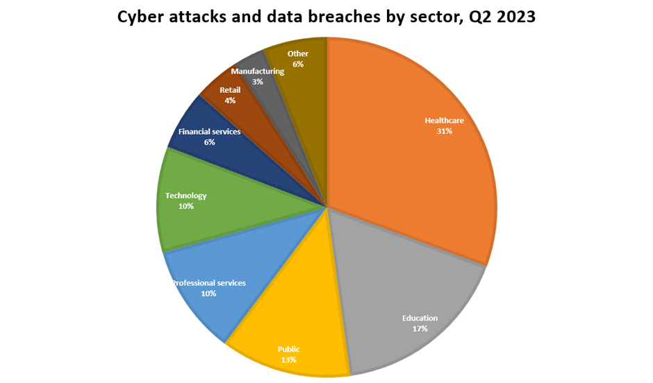
Why Cybersecurity Must Be a Priority
For Individuals:
Protects personal data such as bank information, medical records, and private communications.
Prevents identity theft and financial fraud.
For Organizations:
Prevents costly data breaches that can result in both financial loss and loss of consumer trust.
Ensures business continuity and protects intellectual property.
For Governments:
Safeguards national security from cyber espionage and critical infrastructure attacks.
Protects citizens’ personal data in government databases.

Slide 6
Best Practices in Cybersecurity
Use Strong, Unique Passwords:
Avoid using easily guessed passwords. Incorporate a mix of letters, numbers, and symbols.
Enable Two-Factor Authentication (2FA):
Adds an extra layer of security by requiring a second form of authentication (like a mobile code).
Keep Software and Systems Updated:
Regular updates patch known vulnerabilities that hackers could exploit.
Be Wary of Phishing Attempts:
Always verify the legitimacy of emails and links before clicking.

Slide 7
Interactive Quiz
Question 1: What is the primary purpose of cybersecurity?
A) To protect physical buildings.
B) To protect systems, networks, and data from attacks.
C) To create passwords.
Question 2: Which of the following is a type of malware?
A) Phishing
B) Ransomware
C) Firewall
Question 3: What is the role of two-factor authentication?
A) To slow down hackers
B) To provide an additional layer of security
C) To generate passwords

Slide 8
Summary and Conclusion
Cybersecurity is critical for safeguarding individuals, organizations, and governments from ever-evolving threats in the digital world.
It is essential to adopt best practices and remain vigilant, as cyber attacks can lead to severe consequences, both financially and in terms of reputation.
With emerging threats like AI-driven attacks and quantum computing, cybersecurity must evolve to meet new challenges.
Final Message: Always stay proactive and informed to protect yourself and your data in the digital landscape.

